Slide 1
October 15 – 18, 2024 | Palais des Congrès de Montreal

Slide 2
SLIDE 1: Presentation/Session
The World’s Largest Palliative Care ECHO Session | Palliative Care for Everyone and by Everyone: A Large Global Village

Slide 3
SLIDE 2: Conflict of Interest Declarations
Dr. Luís Fernando Rodrigues, MD, MAHR Palliative Care: No affiliations
Dr. Sreedevi Warrier: Employed by Pallium India, Kerala, India
Dr. Olivia Nguyen, MD, MM, CCMF(SP), FCMF, FRCPC, Palliative Medicine: No affiliations
Miss. Sarah Nyariki: No affiliations
Aparna Gupta, DNP, EMBA, FACHE, CPHQ, ANP-BC: Employed by the National Hospice and Palliative Care Organization / the National Alliance for Care at Home (Feb 2022–current)
Lesley Goodburn: Advisory committee member at the National Cancer Audit Collaborating Centre (NATCAN) + National Pancreatic Cancer Audit (NPaCA) (Jan 2024–current)
Dr. José Pereira, MBChB, CCFP (PC), MSc, FCPC: Employed by Pallium Canada (2017–current) and received grants from CIHR (several over the years)
Jeffrey Moat, CM: Employed by Pallium Canada
The Palliative Care ECHO Project is supported by a financial contribution from Health Canada. The views expressed herein do not necessarily represent the views of Health Canada.

Slide 4
SLIDE 3: Learning Objectives
At the conclusion of this presentation, participants will be able to:
Describe the significance of integrating palliative care into primary care, across specialties and communities.
Identify strategies for promoting international collaboration and raising global awareness of palliative care.
Describe real-world case studies to understand practical applications of palliative care principles in diverse contexts.
Reflect on commitments to advancing global palliative care and fostering worldwide collaboration.

Slide 5
The World’s Largest Palliative Care ECHO Session
Palliative Care for Everyone and by Everyone: A Large Global Village

Slide 6
Sanjeev Arora MD, MACP
Distinguished and Regent’s Professor of Medicine (Gastroenterology/Hepatology)
Director of Project ECHO
Department of Medicine, University of New Mexico Health Sciences Center

Slide 7
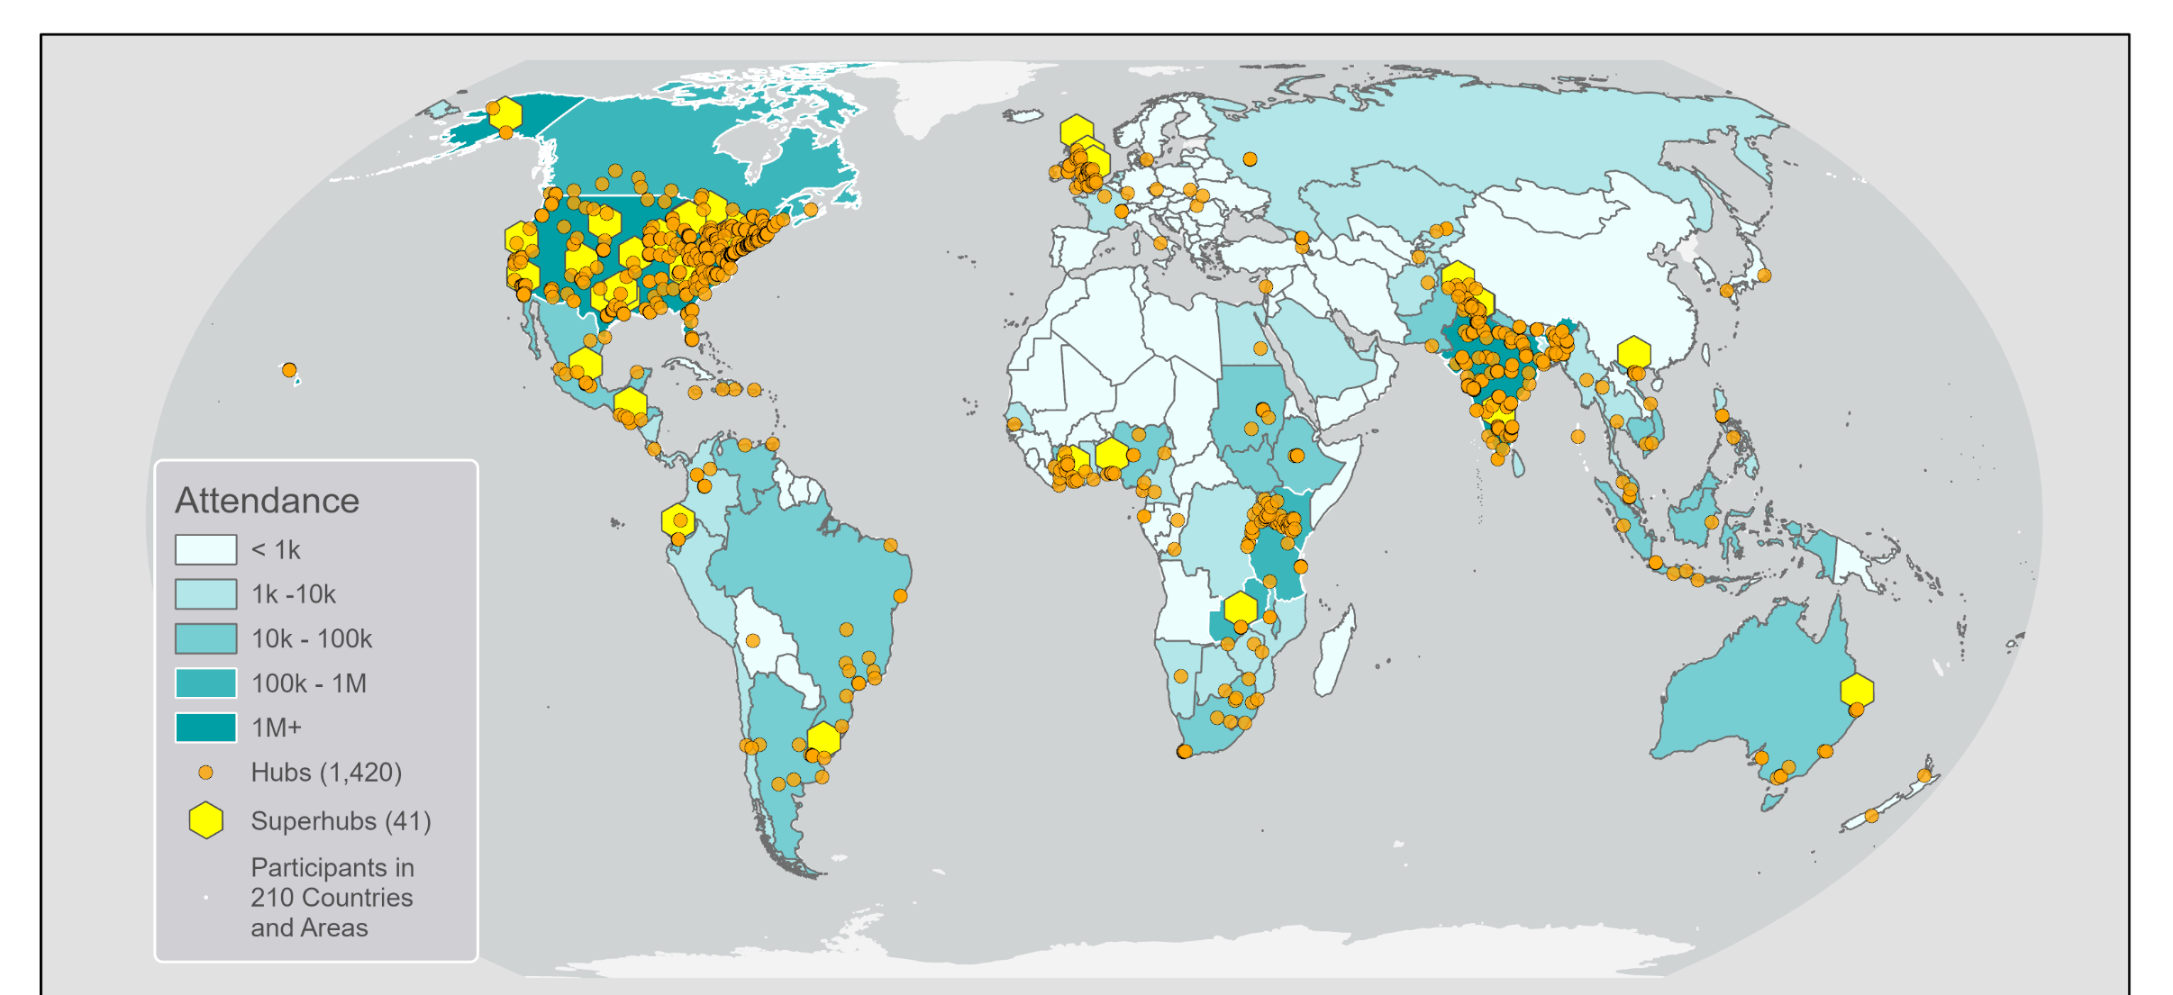
Global Hubs & Superhubs

Slide 8
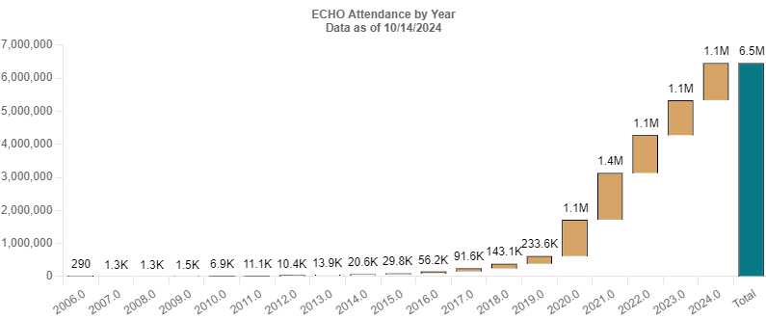
Major Growth In Demand Since COVID 19: Cumulative Attendance Across ECHO Network
Note: Data represents program attendance reported by ECHO Hubs thus far and may not entirely reflect all global ECHO attendance.

Slide 9
Project ECHO Turns Traditional Training on its Head
Evidence Based Best Practices
Virtual platform accessible with minimal internet access
Workshops/ Webinars/ Courses separated from classroom practice
Measuring effectiveness
Ongoing virtual Community
of Practice
Participants travel to experts
HIGH INTENSTITY
LOW FREQUENCY
LOW INTENSITY
HIGH FREQUENCY
Conferences
Feedback loops
for guided iterative practice
Learning best practices led by experts
Learning and discussions led
by experts
Collaborative learning
co-producing evidence-based locally responsive solutions
Mentoring &
ongoing support

Slide 10
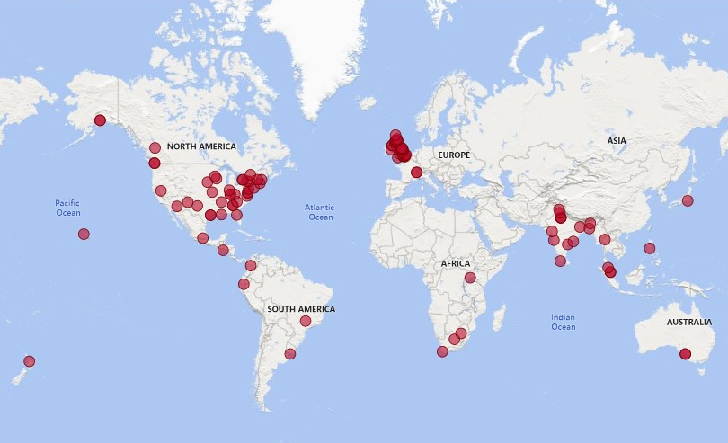
Palliative Care ECHOs Around the World
495
Palliative Care ECHO Programs
120
Palliative Care ECHO Hubs
20
Countries

Slide 11
Across the Continuum of Care
Prevention | Screening | Treatment | Survivorship & End of Life Care
Tobacco cessation HPV vaccination Hepatitis B vaccination Sun safety & skin cancer prevention Community cancer intervention & prevention | Dermatology Breast cancer Cervical & colorectal cancer Oral & lung cancer Pathology best practices Training peer and community health advocates | Pain & toxicity management Cancer care navigation Precision medicine & cancer genomics Clinical trial enrollment | Palliative care Coping Health promotion Follow-up of cancer survivors Caregivers Transition from patient to survivor

Slide 12
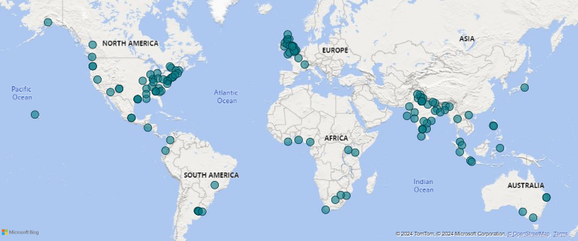
Cancer ECHOs Around the World
864
PROGRAMS
36
COUNTRIES
246
HUBS

Slide 13
Partner With Us
You can:
Get involved with an existing ECHO program.
Start your own ECHO program.
Explore ECHO resources and trainings.
Email us:
ECHOReplication@salud.unm.edu

Slide 14
Panel discussion
Moderated by Jeffrey B. Moat, CM

Slide 15
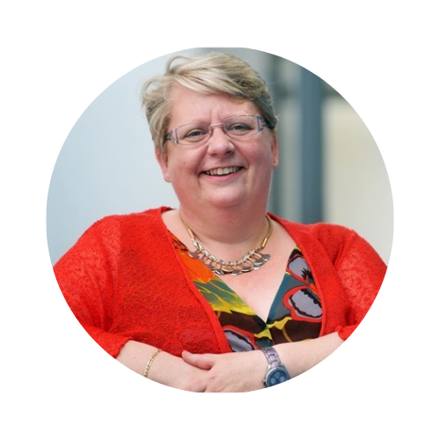
Lesley Goodburn
Representing the United Kingdom

Slide 16
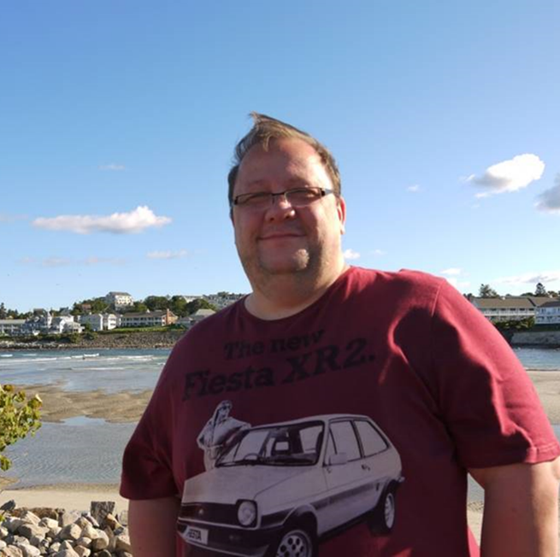
Seth died 33 days after a pancreatic cancer diagnosis
Play
Film
Educational resource
Letters
Digital stories, audio and written
Education
Creativity

Slide 17
What’s needed
Compassion
Listening – with big ears
Responding to needs and wishes
Don’t make assumptions
Shared decision making
Honesty
Kindness
People live until they die

Slide 18
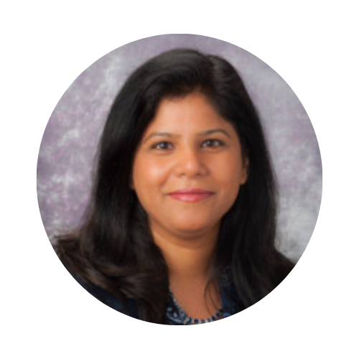
Aparna Gupta DNP, EMBA, FACHE, CPHQ, ANP-BC
Representing the United States of America

Slide 19
NHPCO Project ECHO Model – Where Innovation Meets Quality
Who We Are
The National Alliance for Care At Home (previously National Hospice and Palliative Care Organization NHPCO and National Association for Home Care and Hospice NAHC).
What We Do
The leading authority in transforming care in the home in the United States. We are an inclusive thought leader, advocate, educator, and convener and the unifying voice for those providing and receiving healthcare through all stages of life.
NHPCO Project ECHO Model
Launched In 2021
Quality Improvement in serious illness and at end of life
2022
Topic Examples:
2023
Equity And Access in palliative care and hospice
Topic Examples:
Rural Palliative Care
Voluntary Stopping of Eating and Drinking
Complex Family Dynamics
Medication Management
Age Friendly Health Systems
Quality Improvement in serious illness and at end of life
Music Therapy in Pediatrics
DEIB Certificate Program
Topic Examples:
Caring for the hard of hearing community
Implicit Bias
Culturally-Responsive Trauma Informed Care
2024
Targeted Focus:
1. Best Practices in Dementia Care
For Patients
For Caregivers
2. Dilemmas in Equity and Ethics
Appointed Guardianship
Ethically equitable care in pediatrics

Slide 20
Systems based design and the model
The Approach
Case Recruitment
Faculty Recruitment
Post Session
Evaluation Links
Key Takeaways
Thought Items
Content and marketing coordination
Session Facilitation
Session Evaluation
Data Entry
Session Slides
Session Recordings
Key Takeaways
Knowledge Check / Quiz
Evidence Based References
Real-time/ Live
Conversations Starters
Participant Perspectives
Actionable
The Process
Tri-directional balance
Robust session topic selection
Real-life, de-identified case studies
All-teach, All-learn
Half of the session is dedicated to audience engagement

Slide 21
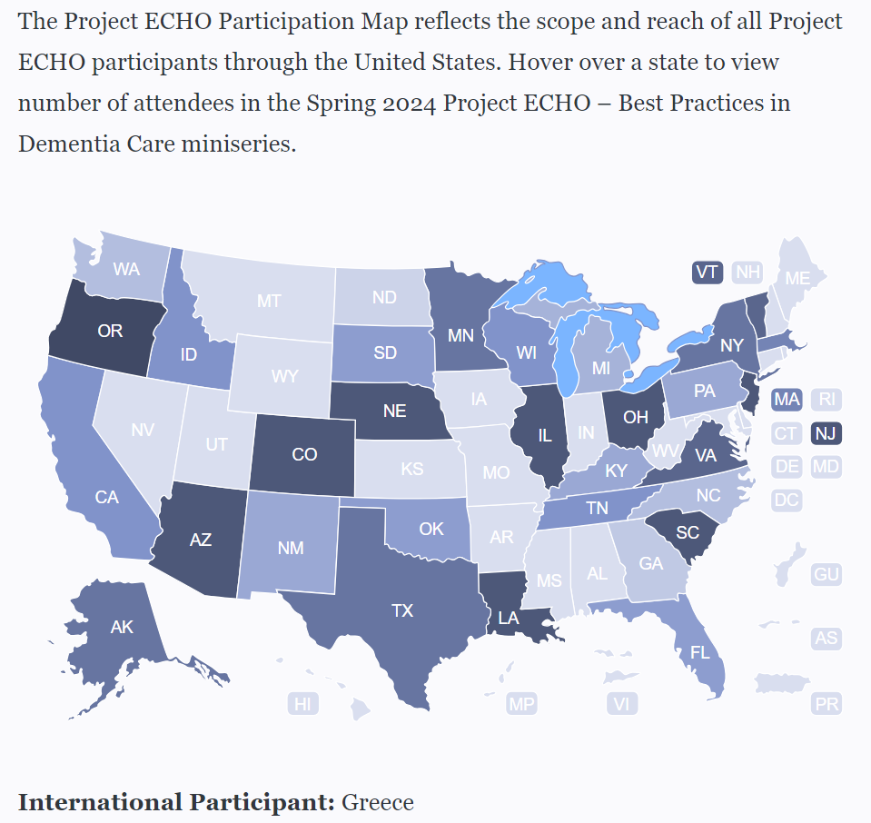
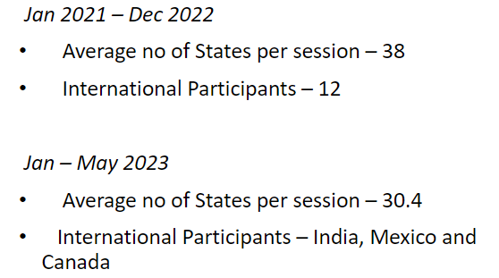
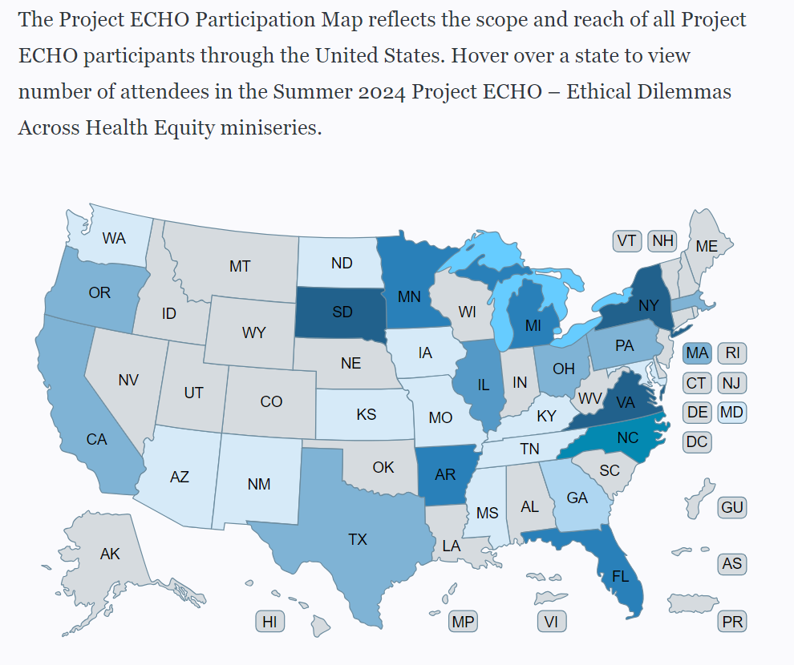
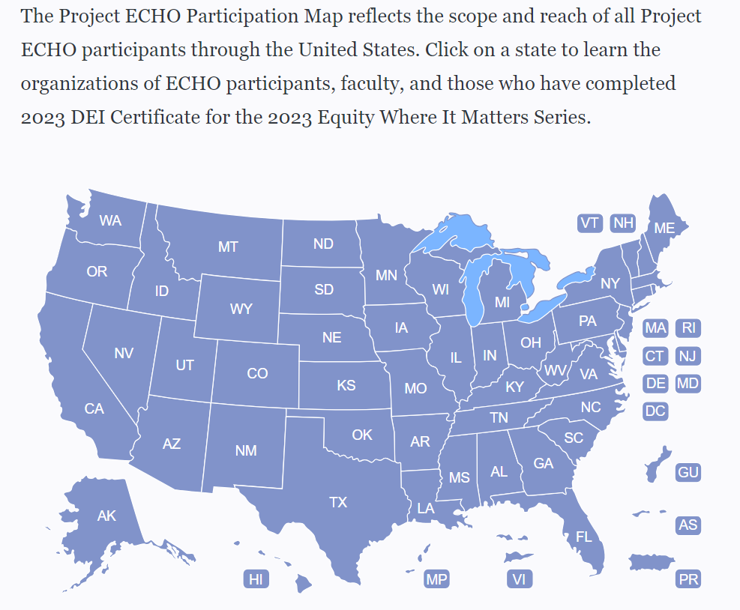
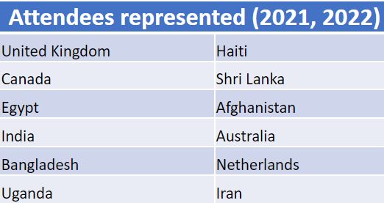
Improving Quality Program Review and Evaluation

Slide 22
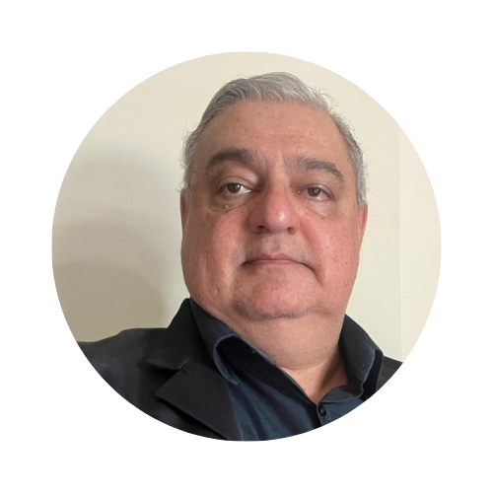
Luís Fernando Rodrigues MD, MAHR Palliative Care
Representing Brazil

Slide 23
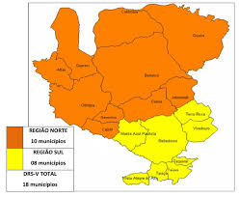
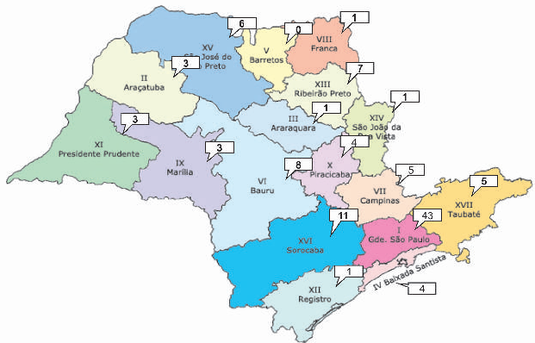
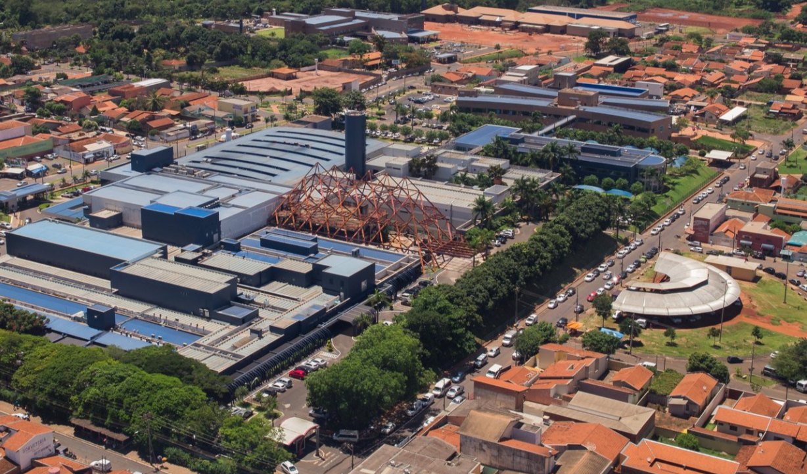
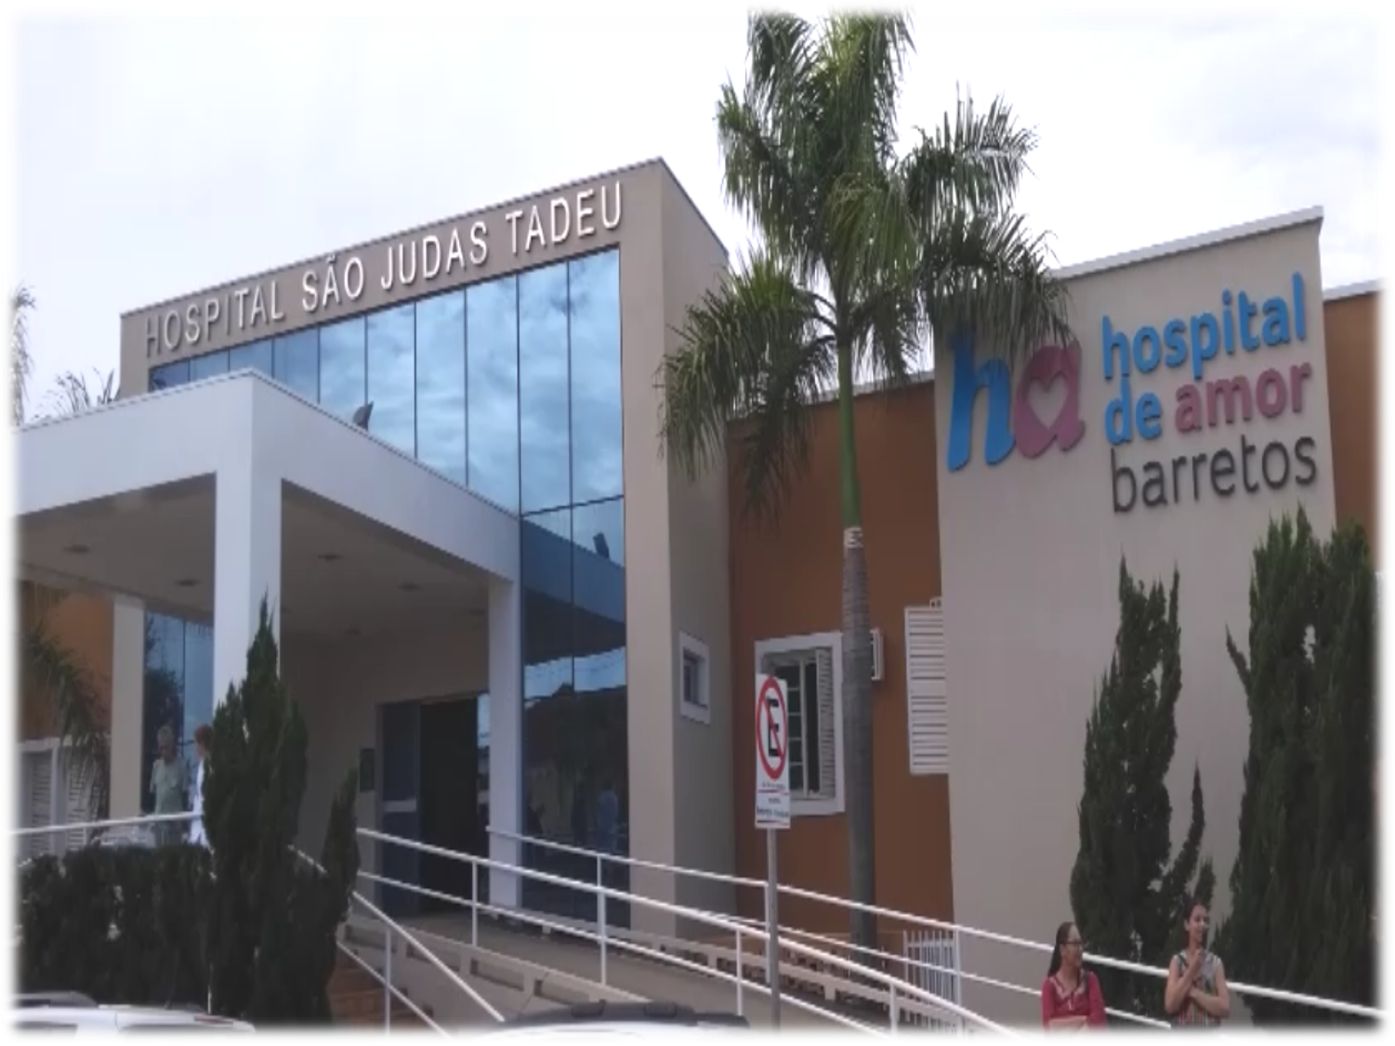
5th Regional Health Department – Barretos HQ
18 cities – 442,899 inhabitants
Area – 8.000 km²
PROJETO ECHO-PREDIA CP
São Paulo State
45,973,94 inhabitants
17 Regional Health departments
Palliative Care Unit
Brasília
Brazil 212,583,750 inhabitants
26 states + 1 federal district

Slide 24
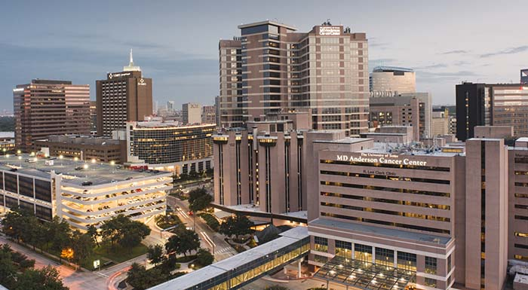
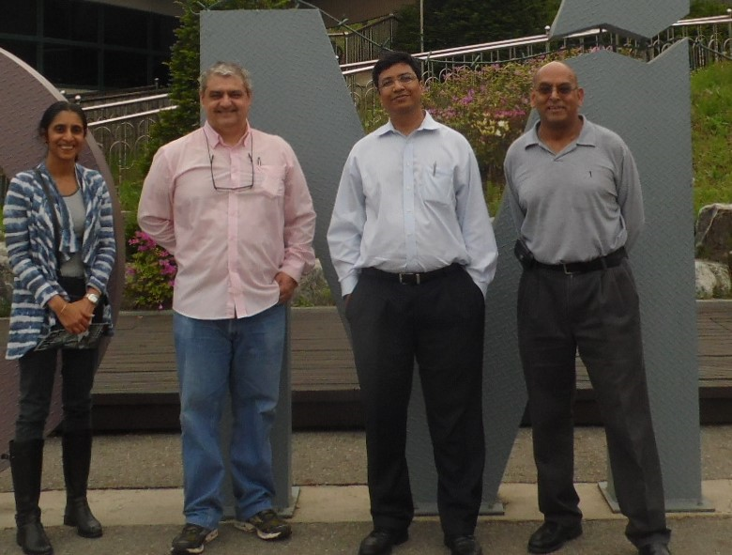
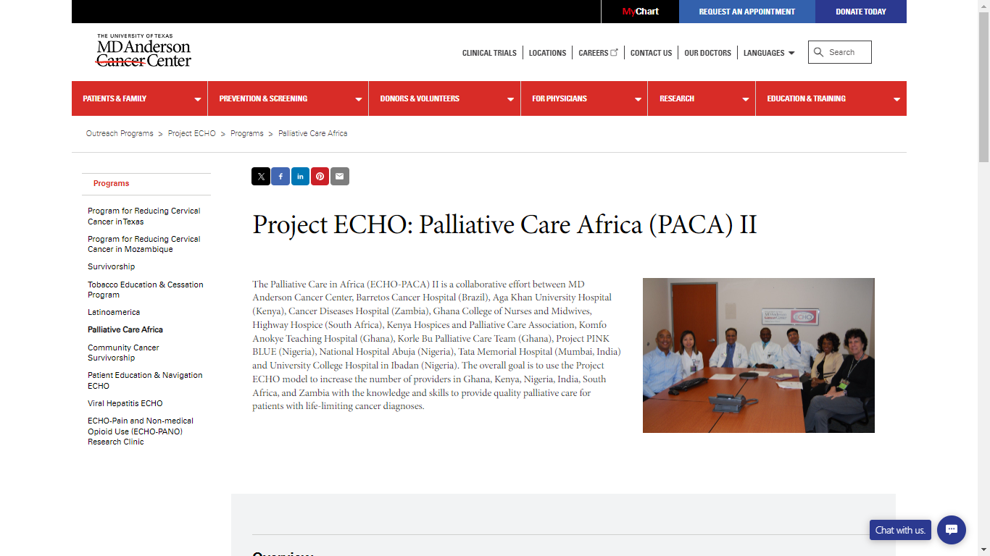
How do we work in Barretos?
Establish syllabus (around 25 main themes)
Create a schedule
Invite Health Secretaries
Open time for registration
Start a cycle
Sessions - every 15 days
We are now on third cycle – each cycle lasts on average 18 months
Certification ceremony (very simple – no glamour)

Slide 25
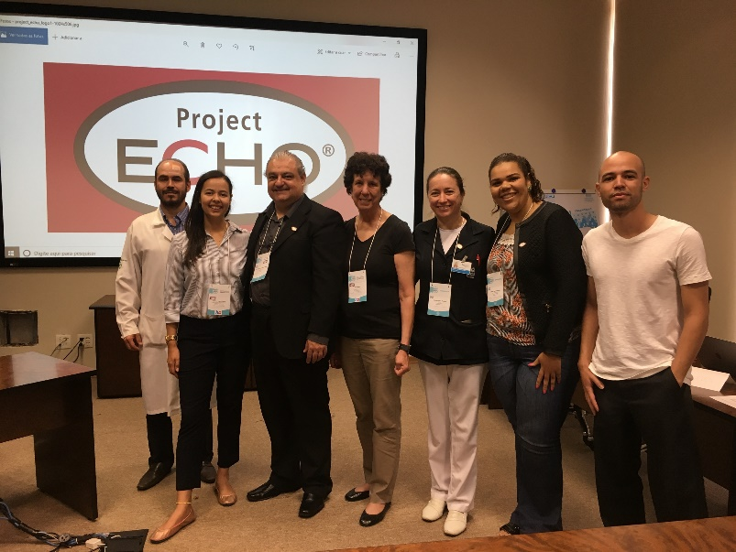
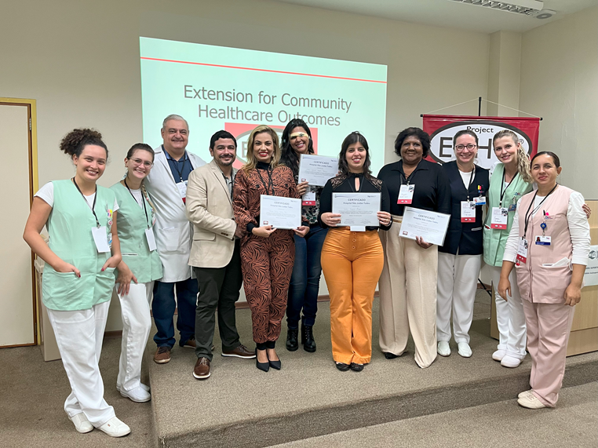
Results from our first experience (2017-18)
Deaths of patients being attended by
 | 2017 (n, %) | 2018 (n, %) | % | p value
Referrals to the HBPCT | 132 | 115 | -12.9% | Not tested
Overall deaths at home or hometown (ODHHT) | 40 | 35 | -12.5% | Not tested
ODHHT – untrained city teams | 29 (72.5) | 22 (62.8) | -24.1% | p=0,013
ODHHTT – trained city teams | 11 (27.5) | 13 (37.1) | +18.2% | p=0,013
Training in Sept. 2019
Cohort 2020 - 2022

Slide 26
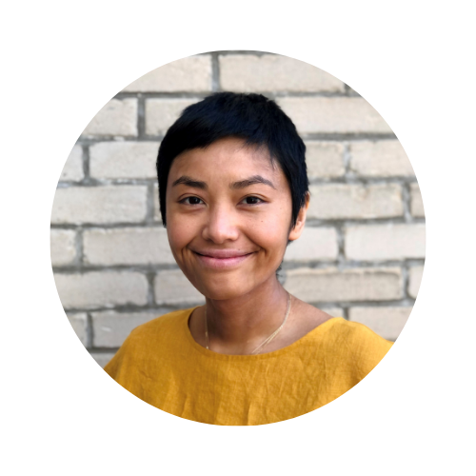
Dr. Olivia Nguyen MD, MM, CCMF(SP), FCMF, FRCPC, Palliative Medicine
Representing Canada (Quebec)

Slide 27
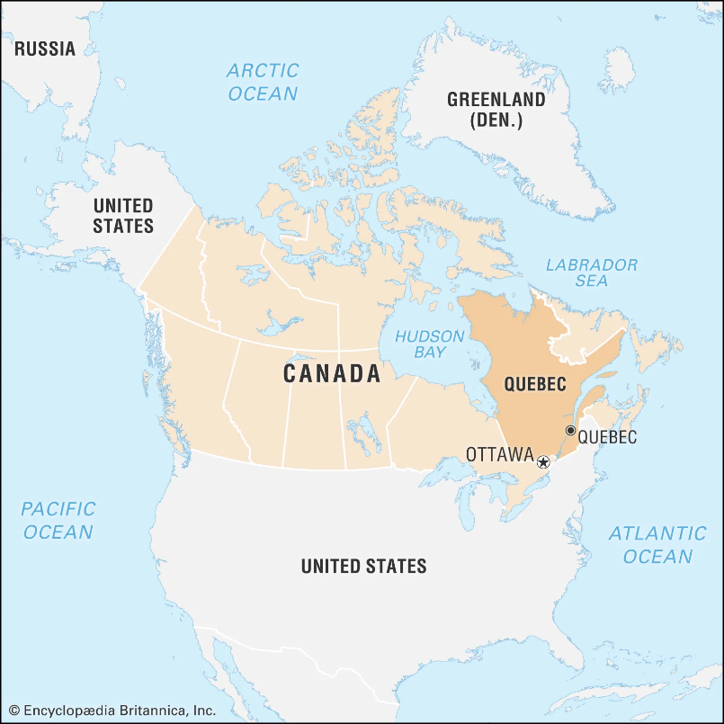

Slide 29
Société

Slide 30
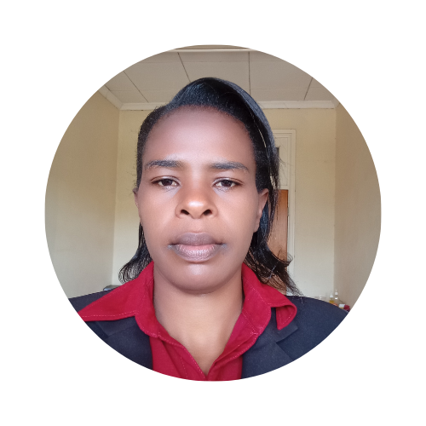
Sarah Nyariki RN, Bsch
Representing Kenya

Slide 31
Create awareness
Community awareness - Need and importance of palliative care.
Educate individuals, families and communities on palliative care.
Clarify myths, misunderstandings, and misconceptions.
Empower CHPs.
Effective referral and linkage.
Capacity-building of palliative care staff.
All levels of health care (community – referral sites).

Slide 32
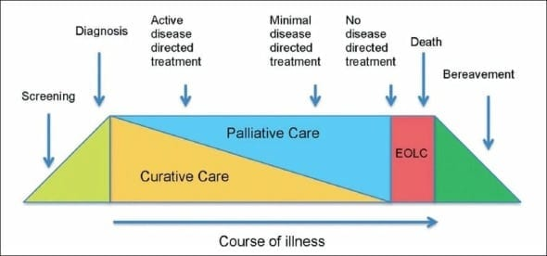
Incorporation in Care Continuum
Multidisciplinary approach in care.
Self-initiative, commitment and passion.
Best palliative care practices across disciplines.

Slide 33
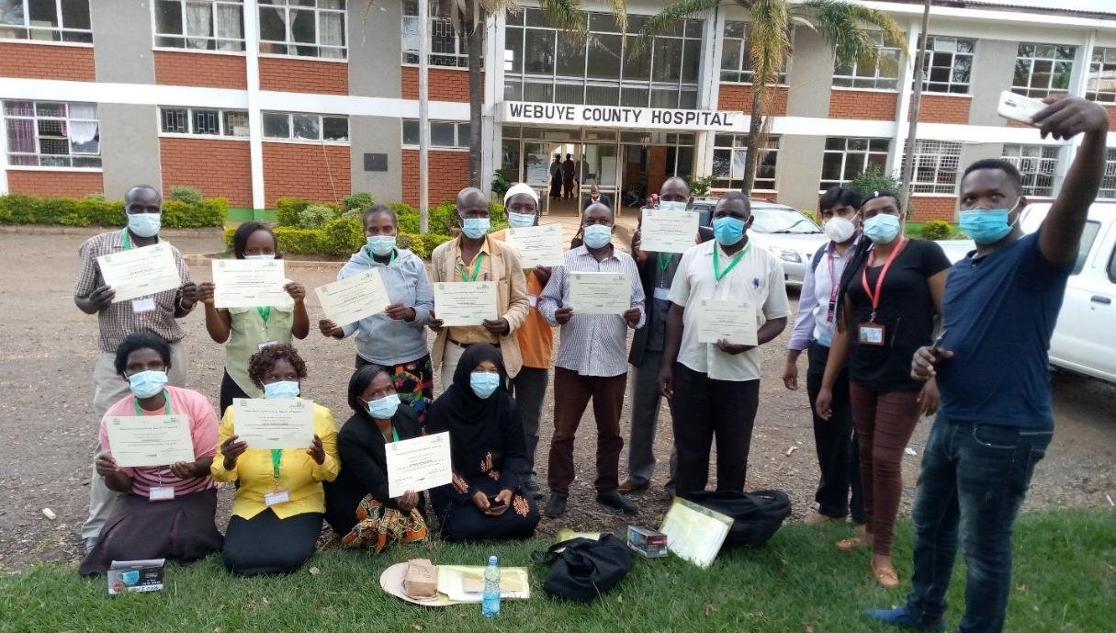
Sustainability
Continuing education and learning experiences (Palliative Care ECHO Project).
Post-training evaluations - improved knowledge, skills, professional isolation and confidence in various categories (CHPS, health care providers, and caregivers).
Patient follow-up systems - telehospice/telecommunication, home visits, etc.
Supportive healthcare systems.
Community, facility and country and global ownership programs.
Notes:
Telehospice Link.
https://www.sciencedirect.com/science/article/abs/pii/S0885392423000593#:~:text=K%20Cornetta%20et%20al.%20Integration%20of%20palliative%20care%20into%20comprehensive
Published-Article-impact on knowledge, attitudes and confidence of CHPs to provide CB PC.
https://#:~:text=Focus%20group%20discussions%20revealed%20the%20CHVs%20ability%20to%20interpret%20symptoms,

Slide 34
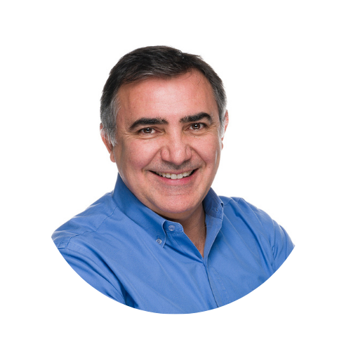
Dr. José Pereira MBChB, CCFP(PC), MSc, PhD
Representing España (Spain)
Notes:
Dr. Jose Pereira MBChB, CCFP(PC), MSc, PhD
Profesor Catedrático, Faculdad Medicina y Instituto Cultura Y Sociedad (ICS), Universidad de Navarra, Pamplona, España.
Clinical Professor, Division of Palliative Care, Department of Family Medicine, McMaster University, Canada
Co-Founder and Scientific Advisor, Pallium Canada
jlpereira@unav.es or jpereira@pallium.ca

Slide 35
Palliative Care in España (Spain)
Summary and highlights
SECPAL: a vibrant national palliative care association
Catalonia World Health Organization Demonstration Project (early 1990s)
Canary Islands palliative care integration (1980s and 1990’s)
Extremadura community: integration across system (1990’s)
CUDECA Foundation and Hospice
New Health Foundation
Atlantes Program, Institute of Culture and Society, University of Navarra: a WHO Collaborating Centre for the Global Monitoring of Palliative Care Development
Pediatric Palliative care in Madrid (Hospital Nino Jesus) and new Children’s Palliative Care Hospital
Efforts across country to integrate in UG and PG curricula of medicine and nursing
Masters degrees in Palliative Care
Pallium Pilot Project in Spain (Dignia Foundation and University of Navarra, in collaboration with Pallium Canada)
Leadership and innovation in several areas of palliative care over the years.
Palliative care in Spain has been gaining recognition and support over the last two decades.
Made big strides in integrating palliative care into healthcare systems over the last three decades, with many regions developing specialized services.
Centres of excellence across the country.
Vibrant scholarship
However, access and availability can vary significantly across the different autonomous communities and regions.
Notes:
I am approaching this from the perspective of someone who has only recently, in the past 18 months, been welcomed to Spain and still on a steep learning curve, not only with the Spanish language and culture, but also the Spanish health care and social systems.
I am learning, acknowledging that the lenses I am using to observe and learn include experiences of having lived in Canada for almost 30 years of my life, and prior to that born, grown up and lived for 28 years in South Africa, the land of my birth, but always connected to my Portuguese roots, where my family is from.
While Spain is very different in many ways to Portugal, where my cultural roots lie, including home language, I am also seeing some similarities and sometimes joint efforts and collaborations..
Spain is a relatively large European country (but much smaller than Canada …… Spain and France alone fit into the province of Ontario in Canada). Population of about 48 million people, with 17 autonomous communities and regions in what is largely a federal system,. Many different cultures and traditions across the country in what is often collectively referred to as Iberian cultures. This includes also four different languages, including Castilian, Catalan, Basque and Galician. Rapidly becoming quite multicultural with immigrants from Latin America and increasingly other parts of the world, including Africa.
Includes recognizing need to integrate palliative care across diseases groups and specialty areas.

Slide 36
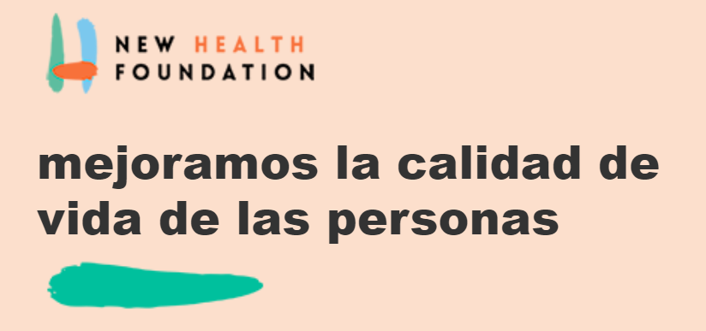
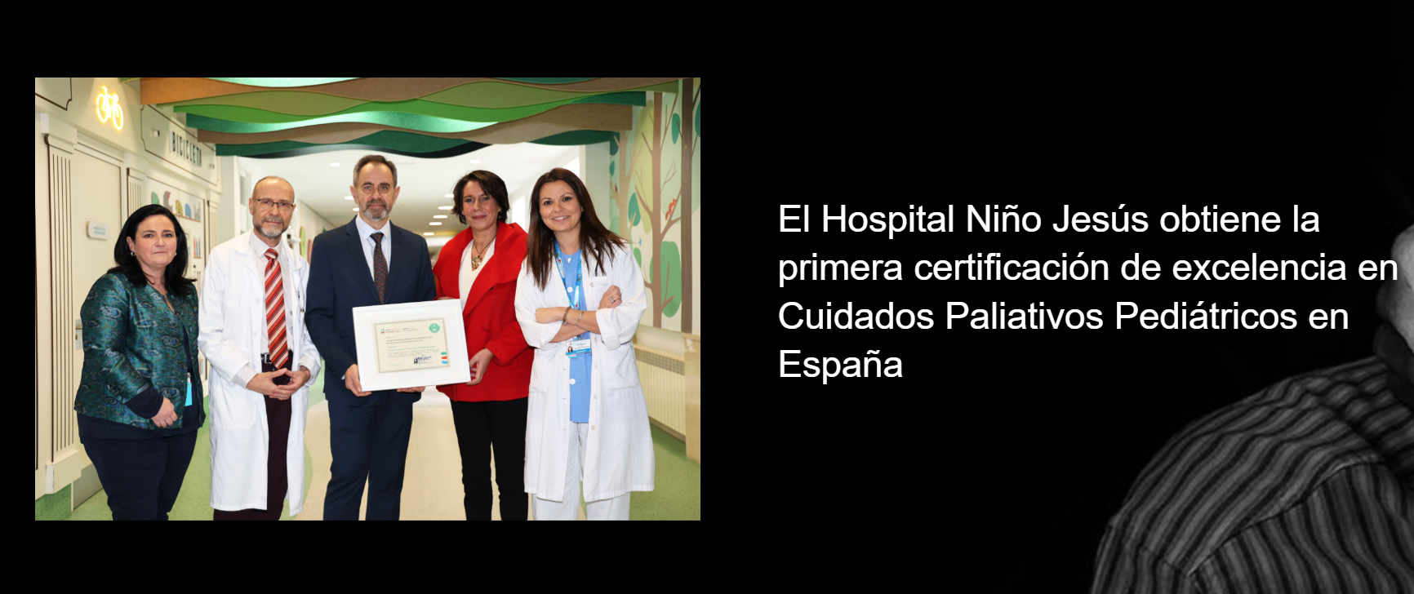
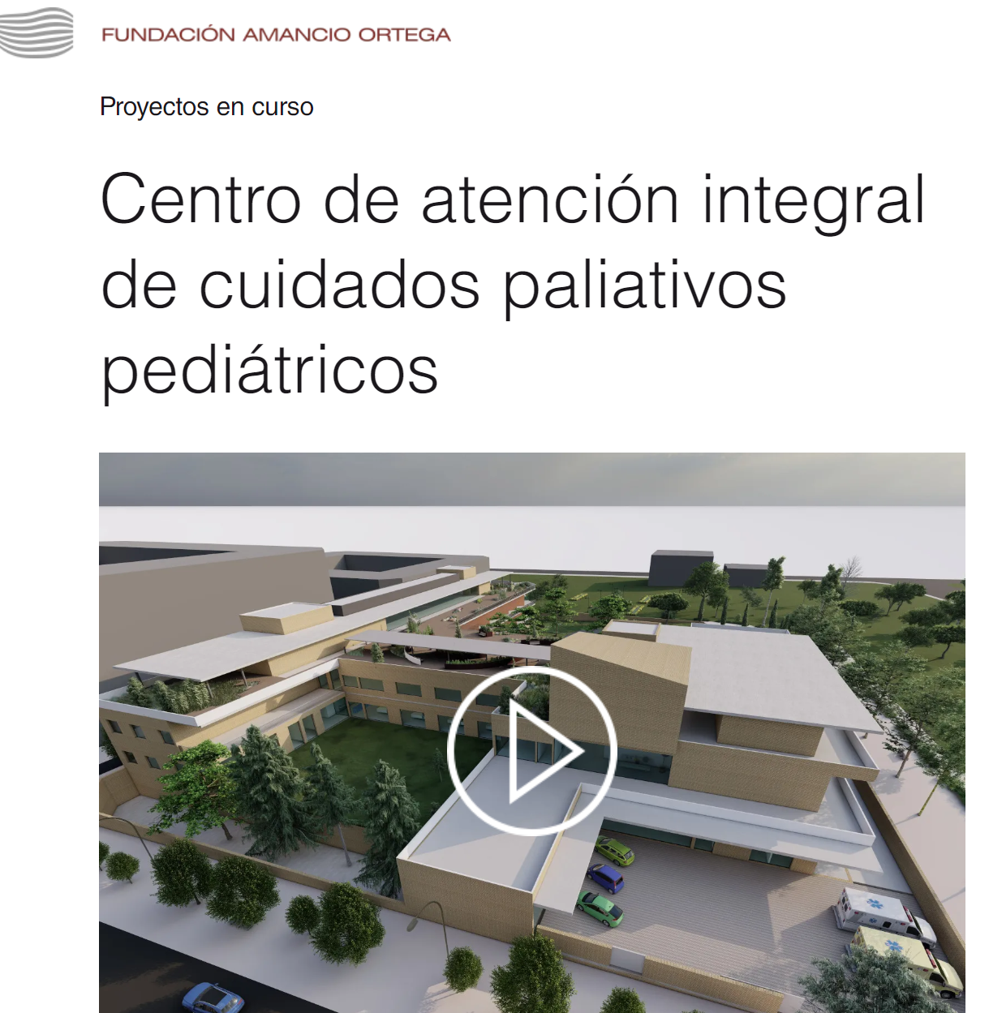
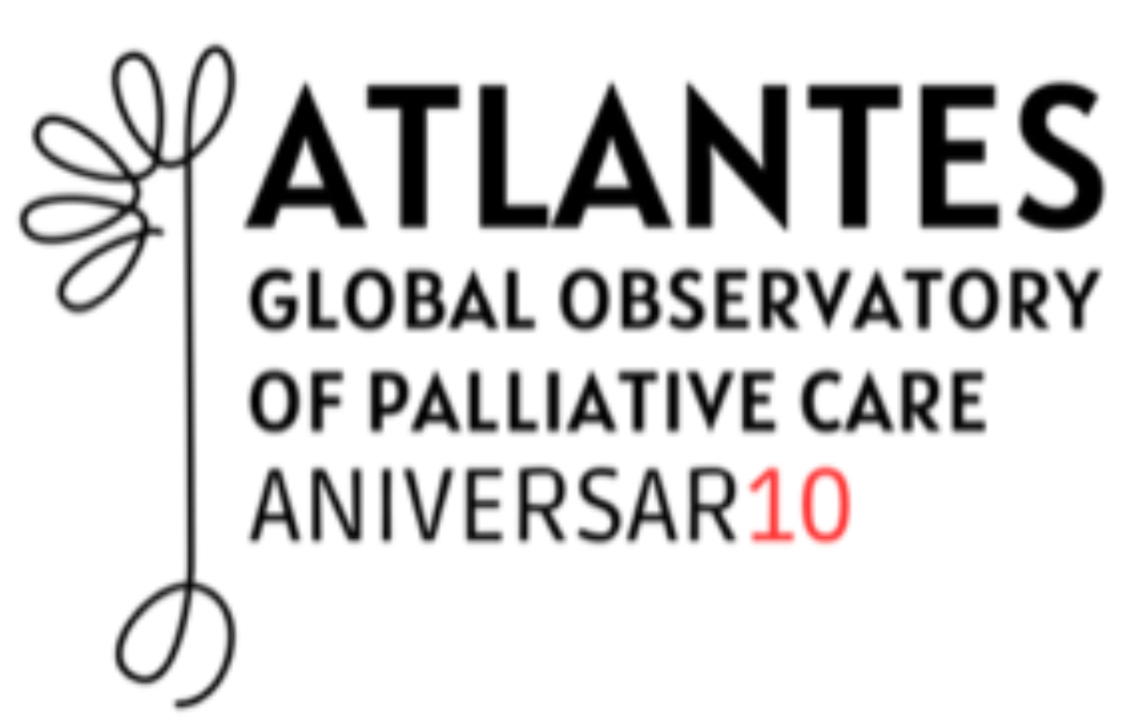
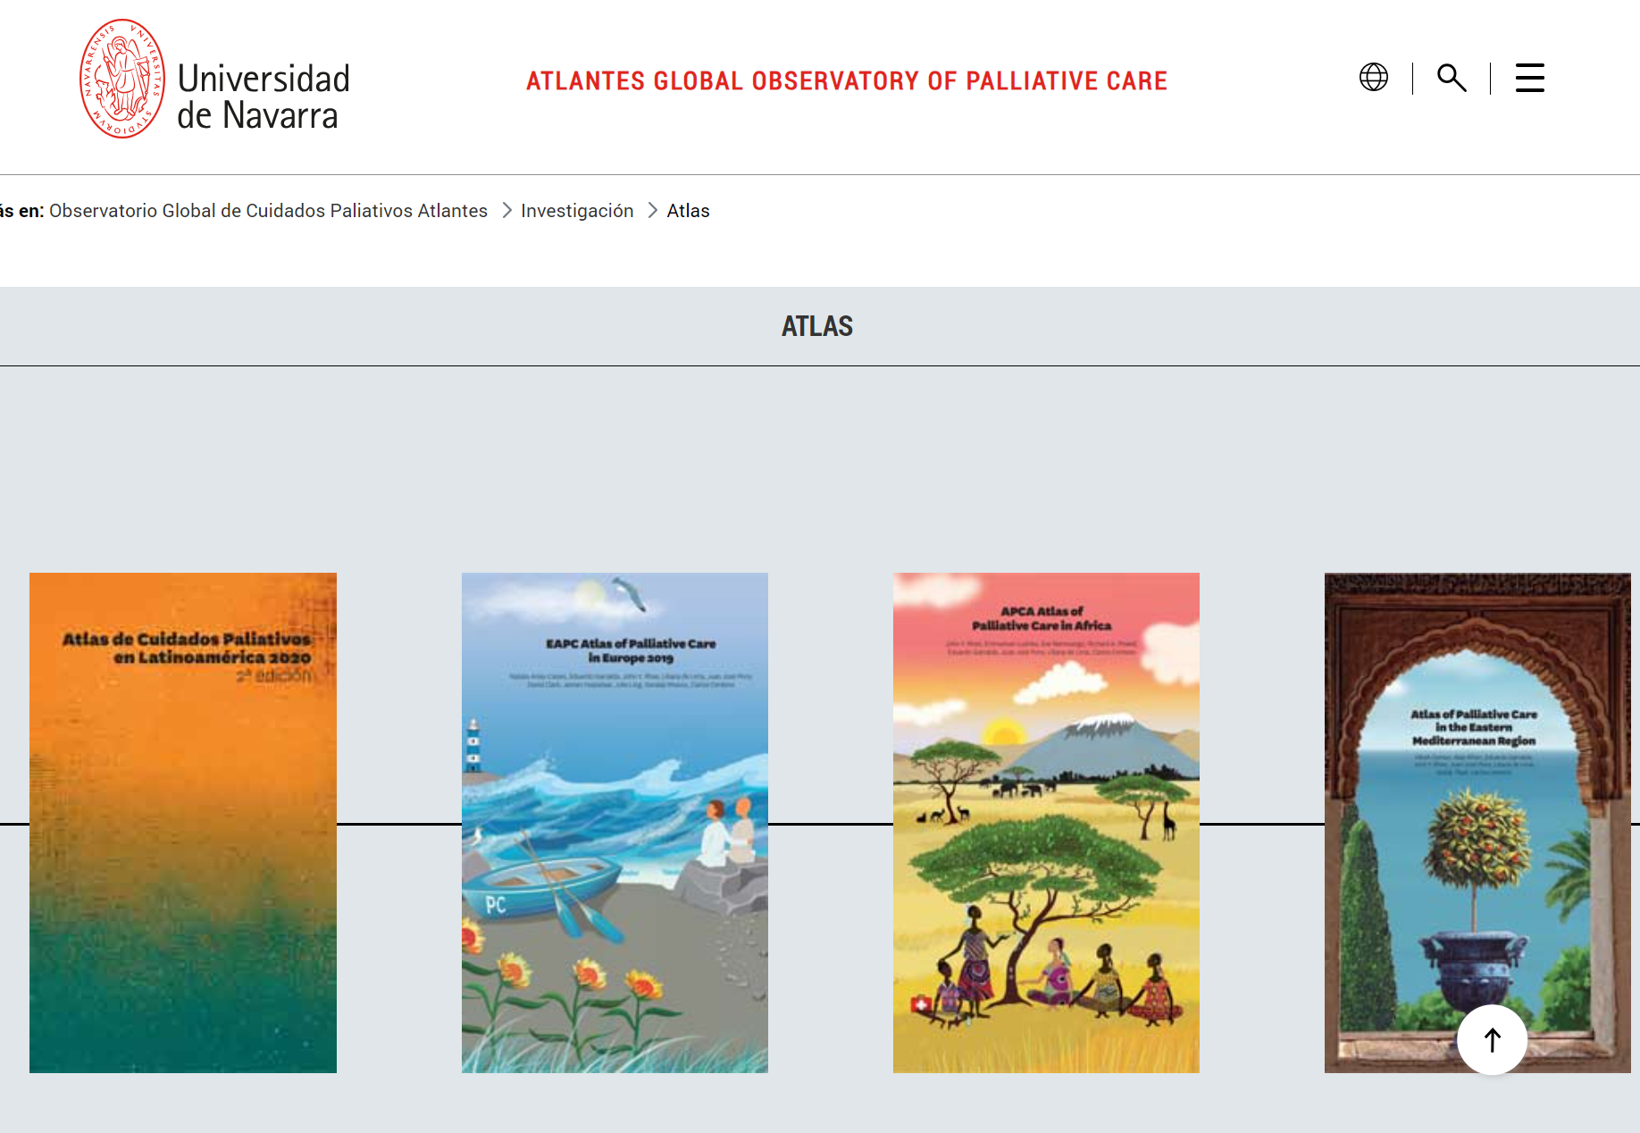
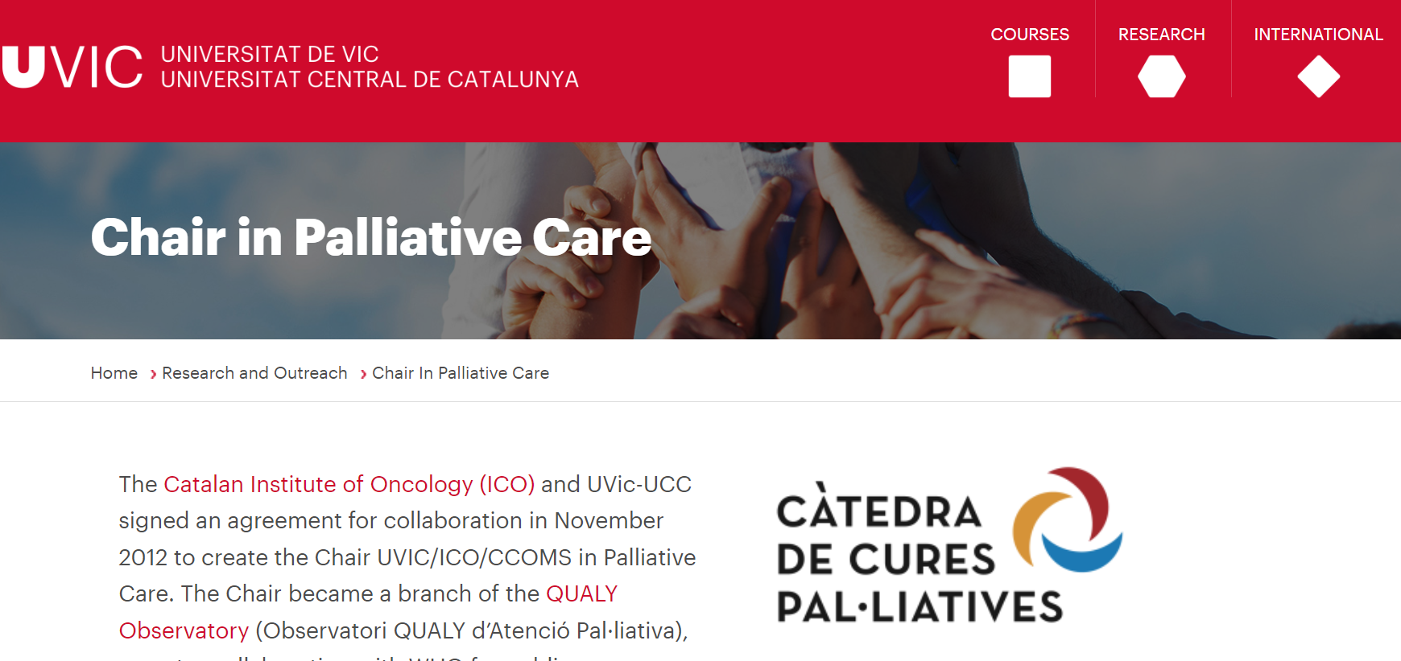

Slide 37
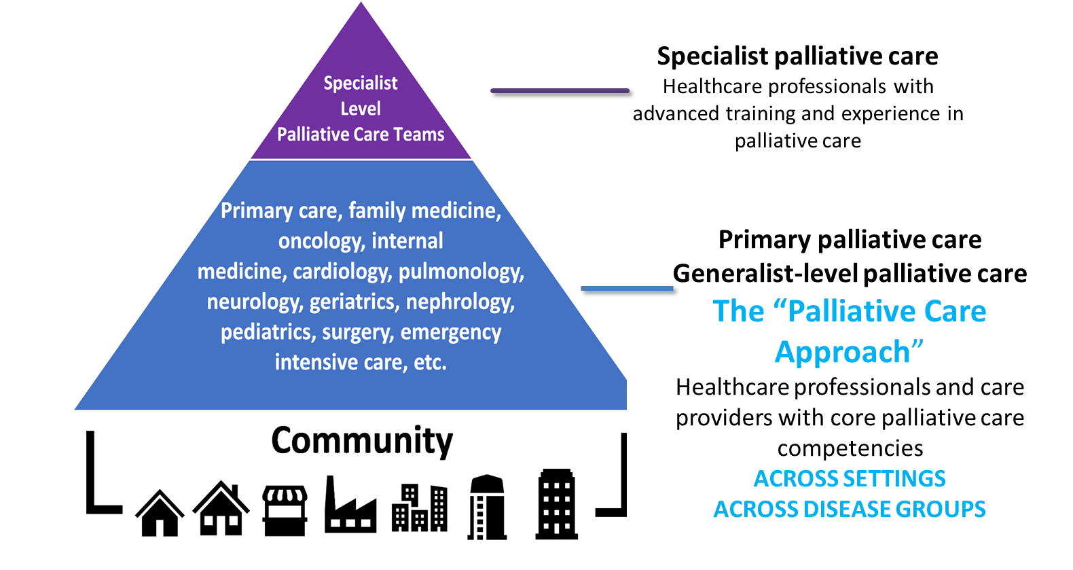
Emerging themes: Spain and Internationally
A public health approach to palliative care
The need to build primary- and generalist-level palliative care
Integration of palliative care in the curricula of the health care professions
Notes:
Recognition of the need for a public health care approach to palliative care
Related to that, is the need to not only ensure access to specialist palliative care services across different care settings, but also to build primary and generalist level palliative care, in which primary care providers and health care providers across many specialty areas and disease groups are equipped with core competencies to allow them to provide a palliative care approach, which includes early identification of patients with palliative care needs, activating a palliative care approach earlier, and referring to specialist palliative care teams when patient needs require it.
Increased efforts to integrate palliative care in the undergraduate and the postgraduate curricula of the health care professions.
Many groups, including the World Health Organization, have advocated for a public health approach to palliative care as an antidote to fragmented service delivery. Multiple scholars, academics, and public health advocates have suggested that a public health approach to palliative care can help with issues of access, equity, and cost. Through the lens of Kingdon's Multiple Streams Framework, this commentary will explore potential reasons why a public health approach to palliative care has not been adopted in the Canadian context and why this is an opportune time to consider this policy innovation. The Compassionate Communities concept is discussed as a potential solution to a public health approach to palliative care delivery..
The overview will be followed by an introduction to the “WHO Public Health Palliative care Model” and the “Health Promoting Palliative Care/Compassionate Communities” by Dr. Allen Kellehear.
By definition, public health combines the science, art, and skills to organize and direct the society’s efforts to protect, maintain, and improve the health and wellness of the whole population and to maximize quality of life when health cannot be restored.
Such public health approached to palliative care view the care at the end of life as everyone’s responsibility. This societal responsibility paradigm is certainly a newer but rapidly growing thought worldwide. As Abel and Kellehear describe in their preface to the focused issue, while a clinical palliative care team can and should address the needs of their patients and their families and loved ones, other interventions that can serve to advance the collective field of palliative care can happen outside of the hospital in such places as the workplace, schools, churches or temples, or other social gathering places.
Both the public health approach and the palliative care approach are based on a common set of conceptual principles.
As illustrated in Figure 4, the public health approach has three core principles that are distinct from those of palliative care and that are key to addressing a health problem or service delivery. 91 1. Population/community-based view 2. Prevention/Promoting-focused 3. Whole-systems approach
All health services worldwide, irrespective of specialty, have a consistent policy and practice approach to their populations. These are:
a population health approach involving education and community development;
a primary health care approach involving non-specialist providers of health care as front line workers for initial assessment, support and intervention;
a tertiary approach involving specialist health care providers and inpatient facilities such as hospitals, clinics, or in the case of palliative care, hospices.
Palliative care began and continues to emphasize tertiary level interventions that emphasizes inpatient facilities and specialist service providers. A primary health care approach is in evidence in some parts of the world with extensive use of general practitioners or community nurses providing initial assessment and sharing responsibilities with specialists in providing adequate interventions. A population health approach to palliative care is the most under-developed at this stage of palliative care service development. Yet, it is the approach that has the most potential to enhance the quality of life and sense of well being to the widest number of people in sickness and in health, in dying and in loss, and in all caring experiences toward one another. Interest in a public health approach to palliative care has been growing worldwide and this is evidenced in the international literature in the field.

Slide 38
Dr. Sreedevi Warrier
Representing India

Slide 39
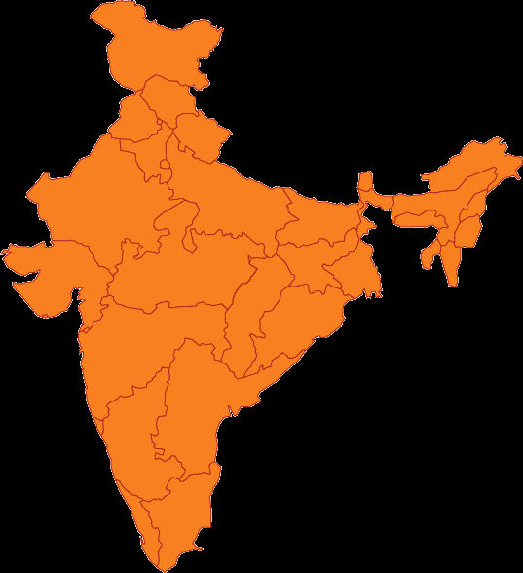
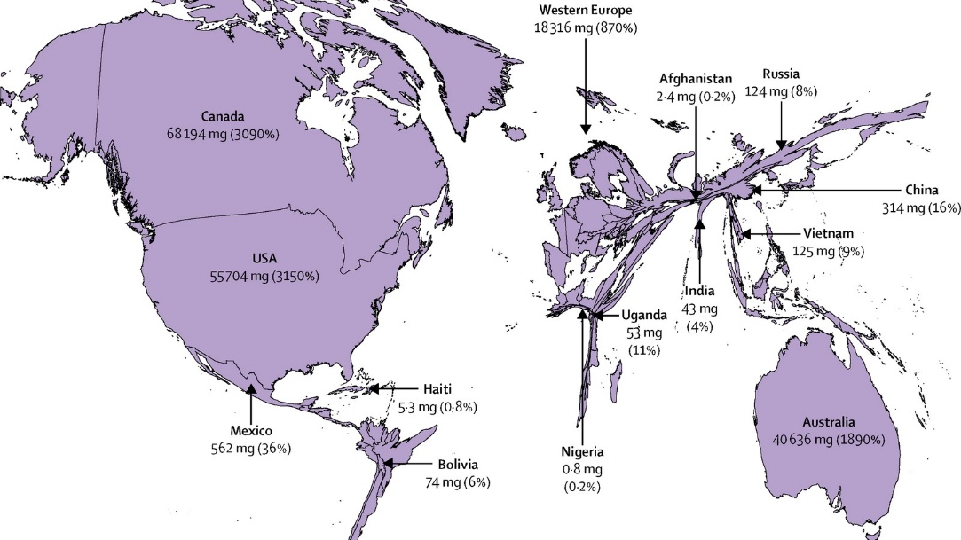
India
Italy
Brazil
Germany
Ukraine
UK
Philippines
Mexico
Egypt
S. Korea
France

Slide 40
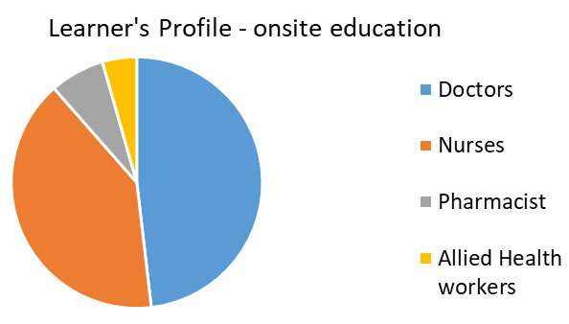
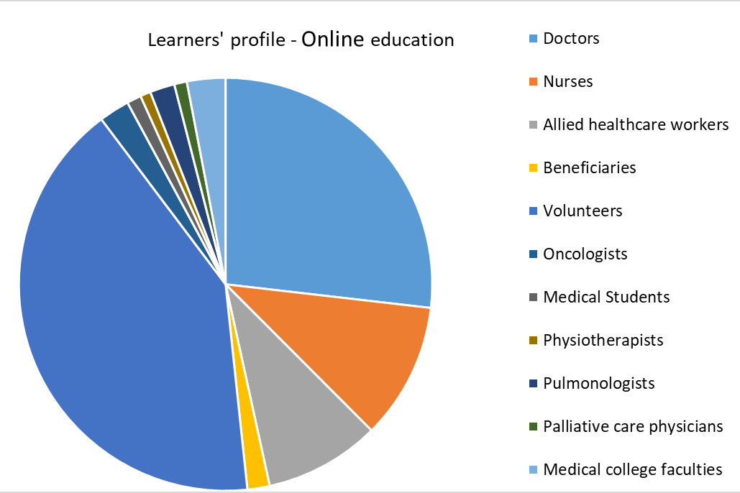
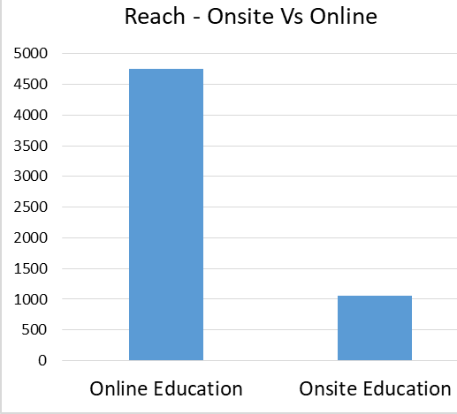

Slide 41
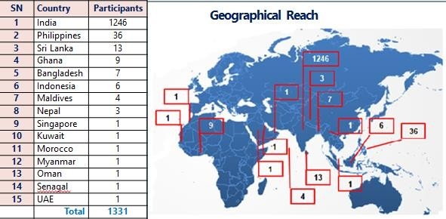
PalliCovid ECHO
Participants Profile
800
600
400
200
0
576
491
Number of Participants
140
Doctors
Nurses
Allied Health
Workers
Others
Notes:
Completed 27 programs – 1331 Participants -15 countries

Slide 42
Q&A

Slide 43
Thank you

Slide 44
What does palliative care mean to you?

Slide 45
Notes:
Video

Slide 46
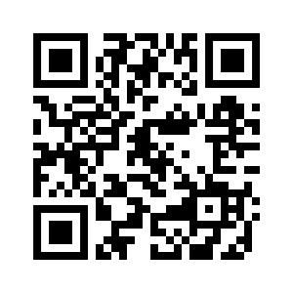
Stay connected with the Palliative Care ECHO Project!
www.echopalliative.com

